Slide 1


Group 2, Project 1: Wonderful World of Wine (Reviews)
Christopher Armstrong
Audelia Torres
Andy Shi
Nyarai Nhamoinesu
Presenters:
Notes:
Requirements: * Title Slide * Include the name of the Project and Group Members

Slide 2
Motivation and Summary
In the US, California is known for their wines, but do they have the “best” wines in the world? How might we go about trying to prove it?
Hypothesis: If California has the “best” wines in the world, then by our metric, they will have the highest professionally rated wine (relative to overall cost) by reviews when compared to the rest of the world.
What should we consider when defining the “best” wine?
How to go about defining which properties make the “best” wine quantitatively, based on review data?
To answer the above questions we explored data from Wine Reviews: https://www.kaggle.com/zynicide/wine-reviews
Notes:
* Motivation & Summary Slide Requirements
* Define the core message or hypothesis of your project.
* Describe the questions you asked, and _why_ you asked them
* Describe whether you were able to answer these questions to your satisfaction, and briefly summarize your findings
This hypothesis still needs work. Dan said it didn’t make sense.
*Presentation tip: We need to explain in this slide what exactly our purpose for choosing this hypothesis we’re questioning. Overall from what we’ve talked about we’re doing it to just figure out what is a good wine and where we can get it from.

Slide 3
Questions and Data
Other Questions Asked:
How would we find which are the top 20 most reviewed states/provinces?
Does California produce the highest quality (professionally rated) wine compared others?
How does California wine reviews compare to the rest of the world when it comes to the variety of wines reviewed?
Does spending more (a higher price) get you better (higher reviewed) wine?
Can we show statistically that wines from California were quantitatively better based on a combination of price and review?
Notes:
Other Questions Asked:
Does California produce the highest quality (professionally rated) wine compared others?
Histogram- will show you the average professional rating of reviews of California wines vs all other wines
How does California wine reviews compare to the rest of the world when it comes to the variety of wines reviewed?
Bar graph showing Top 10 provinces by variety and Pie chart showing the breakdown of top 20 varieties of wine globally (excluding CA) by review count.
Both show higher variety count found in California
Does spending more get you better wine?
Scatter plots showing moderately positive correlation coefficients
Generally, the more expensive the wine, the higher the review rating.
Can we show statistically that wines from California were quantitatively better based on a combination of price and review?
New wine metric was calculated to better evaluate “best” wine
Chi-Square test was performed using average new wine metric for California and Non-California wines
* Elaborate on the questions you asked, describing what kinds of data you needed to answer them, and where you found it
-These are the more narrowed down questions we asked to help answer the broader questions within motivation and summary.

Slide 4
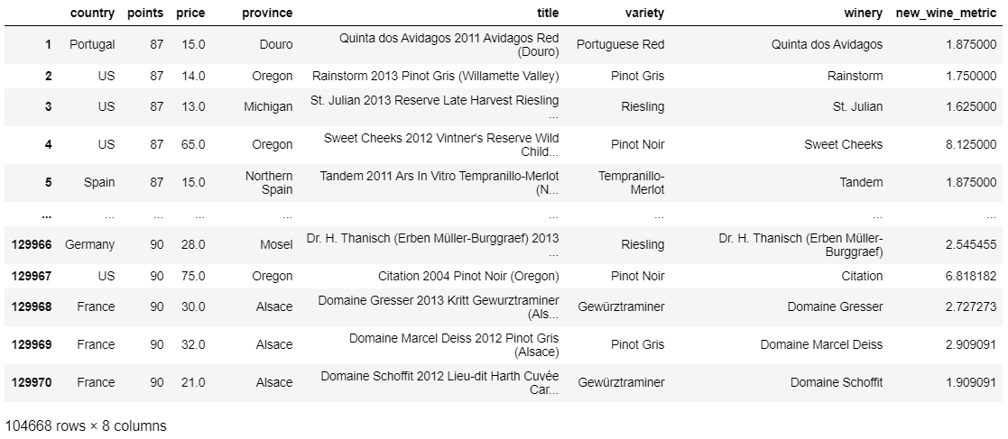
Data Cleanup and Exploration
Initial data collected from https://www.kaggle.com/zynicide/wine-reviews
Our original dataset contained 129,971 records of wine reviews scrapped data was scraped from WineEnthusiast on November 22nd, 2017
We wanted to look at the where, what type, who, and how much?
Notes:
*Describe the exploration and cleanup process
*Discuss insights you had while exploring the data that you didn't anticipate
*Discuss any problems that arose after exploring the data, and how you resolved them
*Present and discuss interesting figures developed during exploration, ideally with the help of Jupyter Notebook

Slide 5
Data Cleanup and Exploration
Imported downloaded CSV as “starter data”
Removed duplicate entries in data, Dropped unneeded columns, Dropped any NaN records in data
Began probative exploration with summarizations and groupings to see what data would be available.
Made a copy of refined data for others to work with
Refined questions from initial data insight and began summarizing what data we had to work with.
Notes:
Original data had to be manipulated to be able to upload “starter” to GitHub.
Description and Designation columns dropped from the original 130k csv to create “dropped_wine_data.csv”
Got the counts of rows in each column.
Dropped unneeded columns.
Dropped any NaN records in the data.
Extracted ‘year’ from column title then recleaned the data for any new NaN values and dropped duplicate values
Renamed and deleted unneeded columns before exporting csv to other people working on the data.

Slide 6
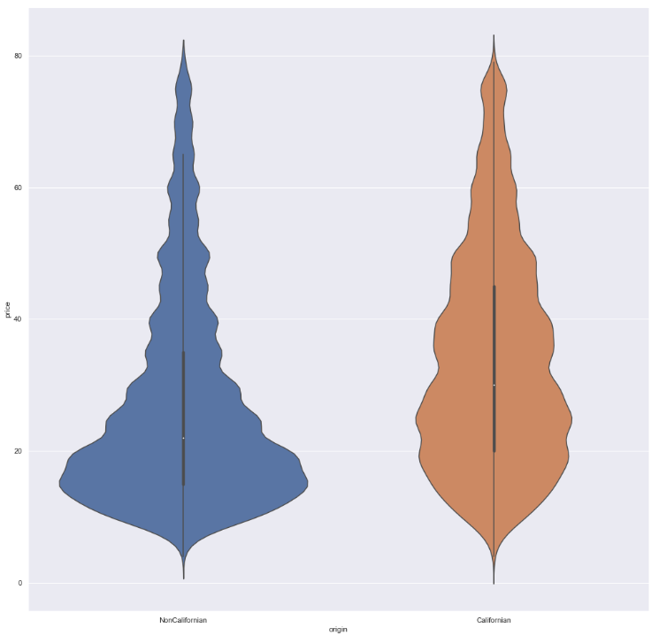
Data Cleanup and Exploration Summary
In total, we made:
4 distribution plots
5 pie plots
4 bar plots
8 scatter/linreg/swarm plots
1 box and whiskers plot
1 violin plot
An attempt at a logistic regression
Multiple IQR’s, T-Tests, Chi Squared tests, ANOVA, RMSE
And over 500 lines of code

Slide 7
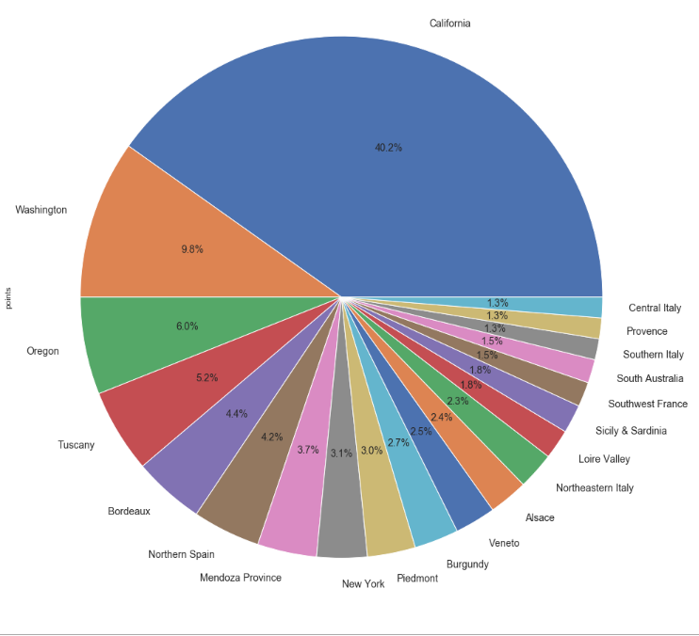
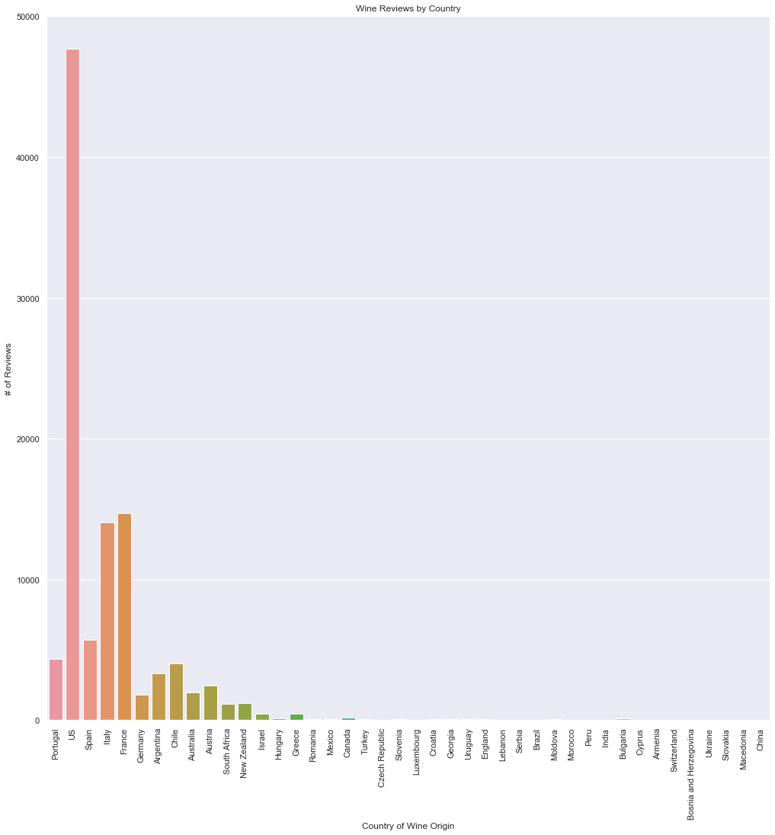
Data Analysis: Breakdown of Reviews
Of the 104,668 reviews remaining, there were 61 distinct state/provinces.
Of the top 20 state/provinces of origin (tot=78,193 reviews), California comprised 29% of the reviews (31,140 reviews) and 26.08% of total reviews while the US as a whole made up 48.8% of the total review.
- Breakdown of Top 20 most reviewed states/provinces

Slide 8
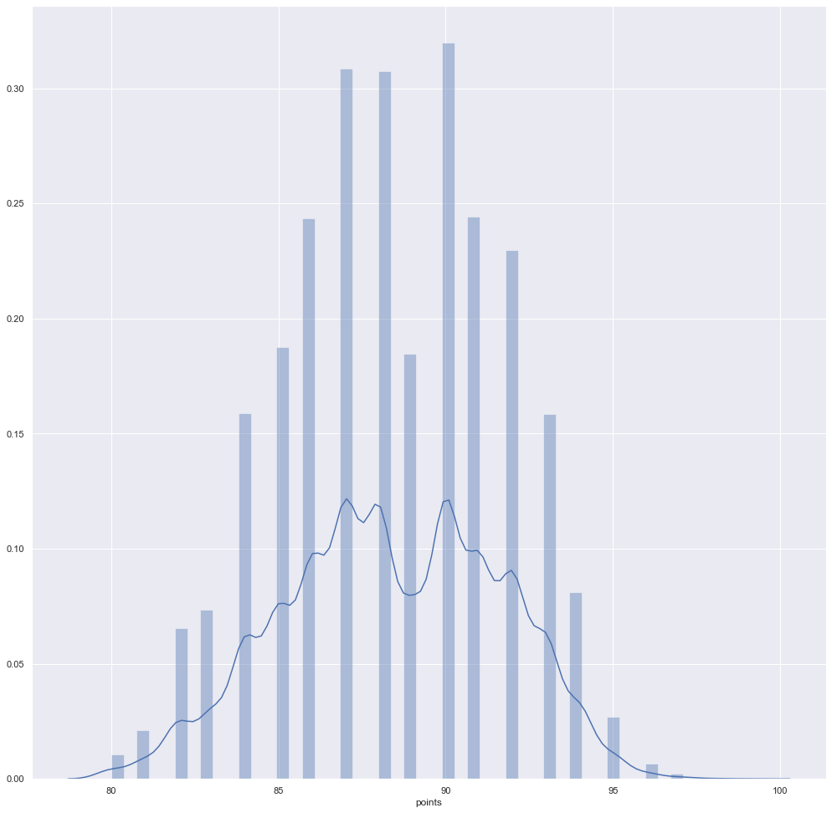
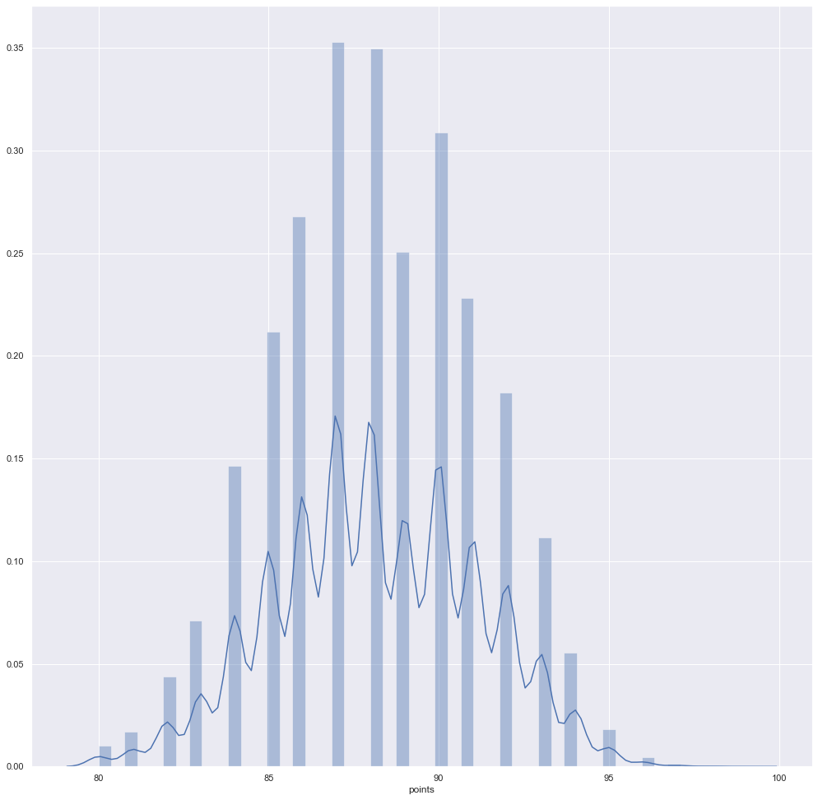
Does California produce the highest quality (professionally rated) wine compared others?
Histogram of California Review Rating
Histogram of Global Review Ratings
Average professional rating of 33,526 reviews of Californian wines is 88.619, and 88.325 for all other wines.
Greater variability of ratings among California wine reviews.

Slide 9
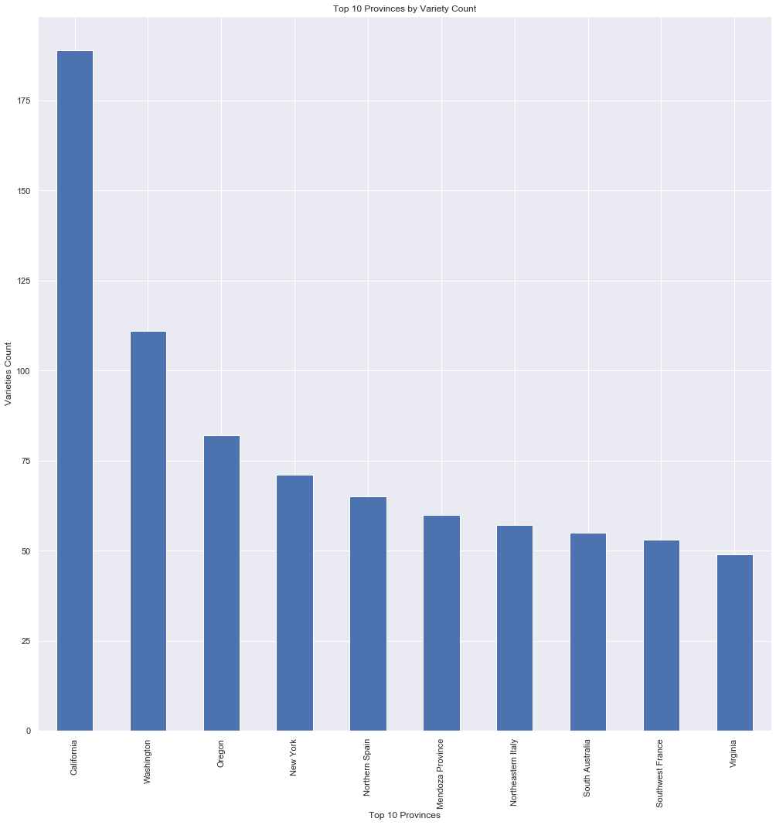
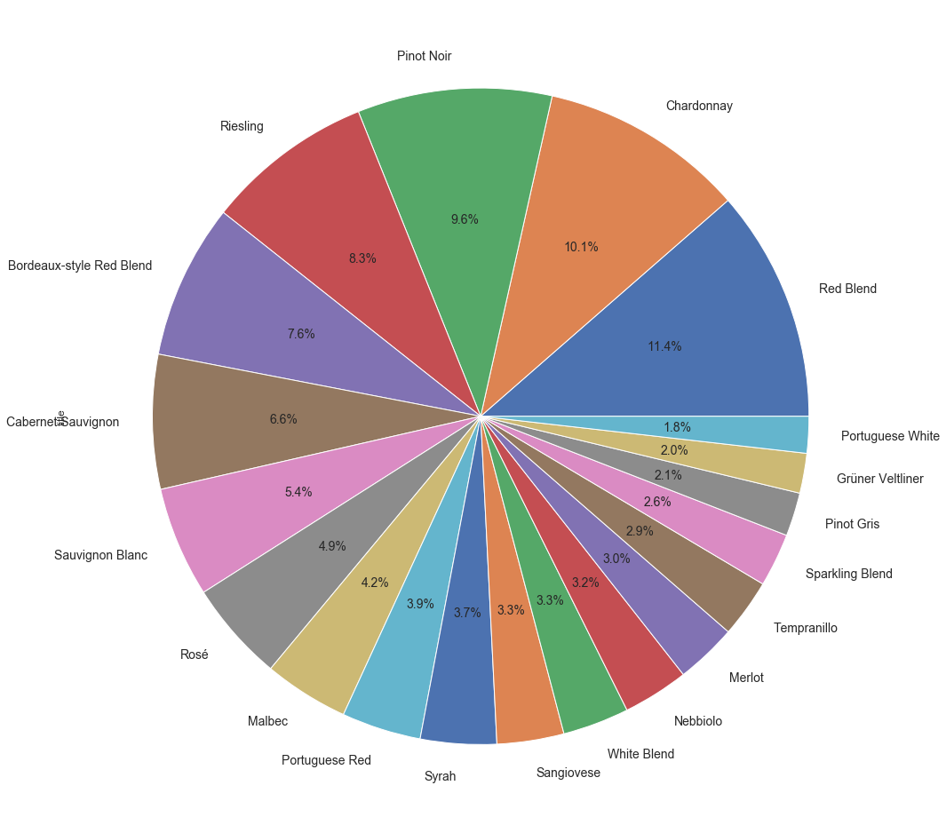
How does California wine reviews compare to the rest of the world when it comes to the variety of wines reviewed?
Higher variety count found in California
12 of the top 20 varieties found in CA are found within the top 20 varieties globally (excluding CA)
Breakdown of top 20 varieties of wine globally (excluding CA) by review count

Slide 10
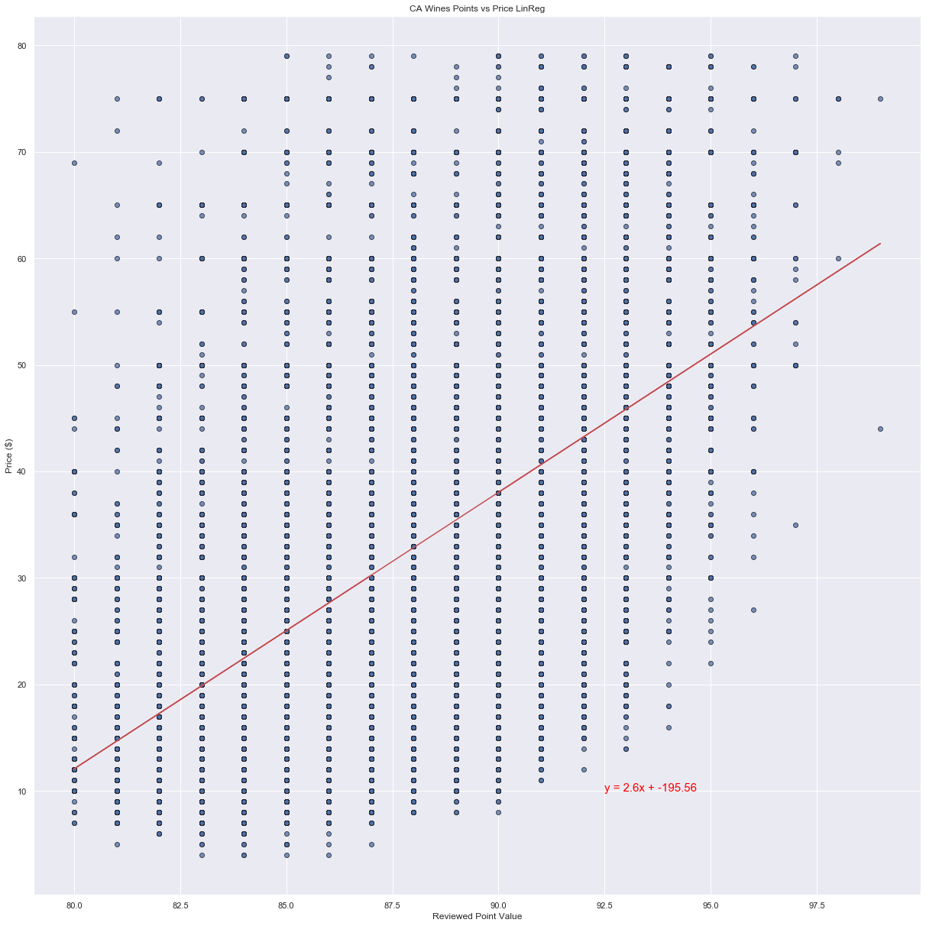
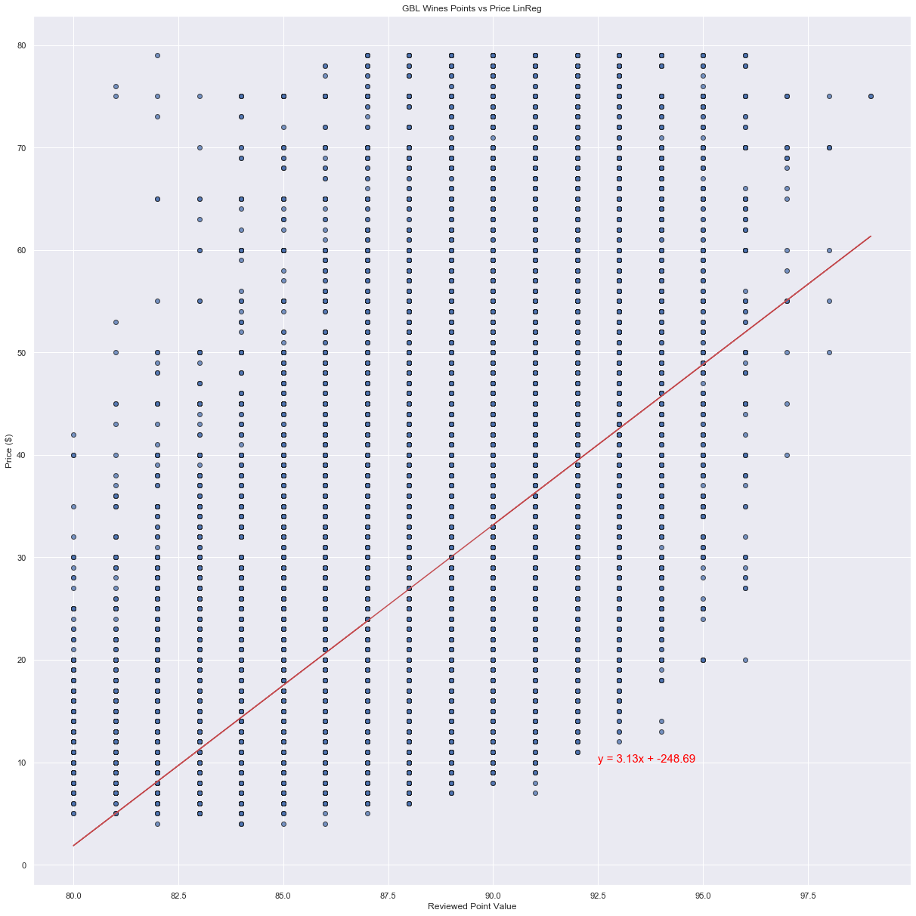
Does spending more get you better wine?
Moderately positive correlation coefficients observed in both plots.
Generally, the more expensive the wine, the higher the review rating.
r = 0.51
r = 0.56

Slide 11
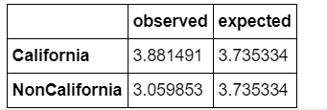
Data Analysis: Chi-Square test
New Wine Metric was calculated to better evaluate “best” wine
New Wine Metric = price/points - 79
Chi-Square test was performed using average new wine metric for California and Non-California wines
Null hypothesis: There is no significant statistical difference between the observed wine metric values and our expected.
Critical Value = 3.841 X² = 0.128
We would not reject our null hypothesis as X² is lower than our critical value.

Slide 12

Discussion/Findings
Most reviews were based on wine that came from US. Wine Enthusiast is a US Based Company and likely targets a US audience.
Pinot Noir was the most frequently reviewed wine type in our dataset but only if we included the California otherwise it fell to 3rd.
California Zinfandel while in the top 5 most reviewed wine from America wasn’t even in the top 20 worldwide
There is an ample selection (at least 312 from our data) of “good value” wines where your money will go further.
This Photo by Unknown Author is licensed under CC BY-SA
Notes:
*Discuss your findings. Did you find what you expected to find? If not, why not? What inferences or general conclusions can you draw from your analysis?
-what was the country of origin---found it interesting it was mainly in the us
if there was a certain wine that was reviewed more than another—pinot noir is second chardonnay
-california and globally were the same
California is know for it’s zinfandel (#5)…but it’s not important to the rest of the world
Variety looking at top 20 wines reviewed vs.
Most wines fell under $250 per dollar

Slide 13


Postmortem
Difficulties:
Data Sourcing – Finding our Dataset
Beer API Challenges
Git Challenges with branching merging and resolving code conflicts
Timeline and Project Organizational Challenges
API Challenges – trying to think of creative ways to use the dataset to leverage semi familiar Google API’s
IF we had to do it again what could we do differently:
Additional datasets could have given us a perhaps a different perspective on what questions we could ask about our topic.
Notes:
*Discuss any difficulties that arose, and how you dealt with them
-We struggled finding a good data source that was both free and had a good range of data to manage. On the 2nd day we had to change our project from beer to wine.
-Git branch was difficult for quite a few of us.
-Personal group wise difficulties…distribution of the project. So broad we didn’t know how to tackle it.
*Discuss any additional questions that came up, but which you didn't have time to answer: What would you research next, if you had two more weeks?
-We did think about doing a heat map of wineries in case if any enthusiasts ever wanted to go on a winery tour. However our data did not include coordinates so to actually get them all in a map it would’ve been a lengthy process we could not go through.
-Maybe grab more datasets.

Slide 14


Q&A with Audience

